Slide 1

AMCAT – An Exploratory Data Analysis

Slide 2
About me
Background
MCM Student specializing Computer Application
Why you want to learn Data Science
Passion for leveraging technology to derive insights and solve complex problems.
Aiming to apply data science to innovate and contribute to real-world solutions.
Any work experience
Data Science Intern at Innomatics Research Labs, specializing in Data Science.
Data Science Intern by CodeClause

Slide 3
Agenda (This should be the PPT flow)
Business Problem and Use case domain understanding(If Required)
Business problem often addressed with AMCAT (Aspiring Minds Computer Adaptive Test) data analysis revolves around assessing the employability of candidates. Companies are looking to streamline their hiring processes by identifying the right candidates based on their skills and competencies. The challenge is to accurately evaluate candidates' skills in a way that predicts their future performance in a job role
Use Case Domain
Recruitment and Hiring - Companies use AMCAT scores to filter candidates during the recruitment process. By analyzing the dataset, organizations can identify which skills are most predictive of job success, helping to refine their selection criteria.
2. Skill Gap Analysis*: Organizations can analyze the dataset to identify common skill gaps among candidates. This information can guide training and development programs to better prepare potential employees.
3. Job Role Suitability: By correlating candidate scores with job performance metrics, businesses can determine which AMCAT assessments are most relevant for specific roles. This can help in tailoring job descriptions and requirements.

Slide 4
Objective
The objective of an AMCAT dataset project is to evaluate candidate skills, predict job performance, identify skill gaps, optimize recruitment processes, analyze market trends, and enhance the candidate experience. Basically, it aims to use data to improve hiring practices and align skills with job market needs.

Slide 5
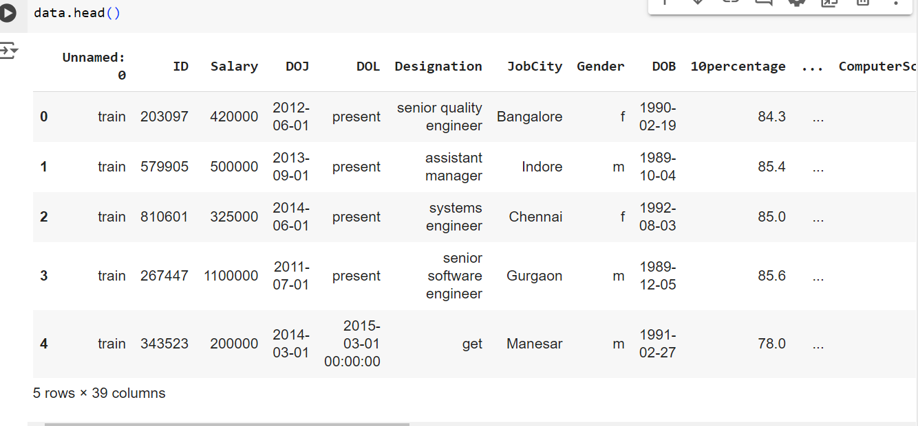
Dataset Overview The dataset consists of 3998 entries and 39 columns. Columns include information such as ID, Salary, Date of Joining (DOJ), Date of Leaving (DOL), Designation, JobCity, Gender, Date of Birth (DOB), 10th and 12th percentage, and many more.

Slide 6

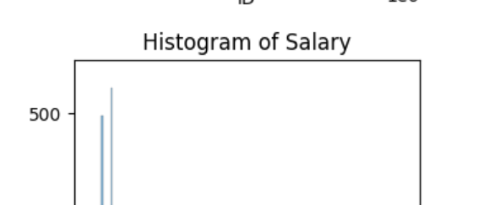
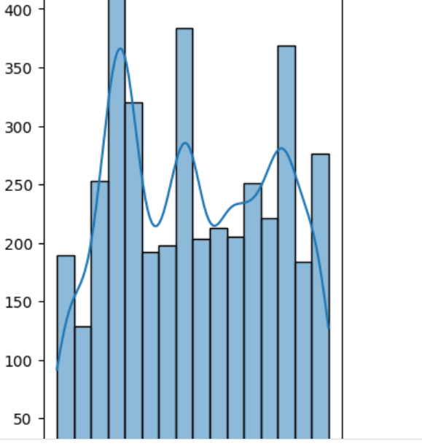
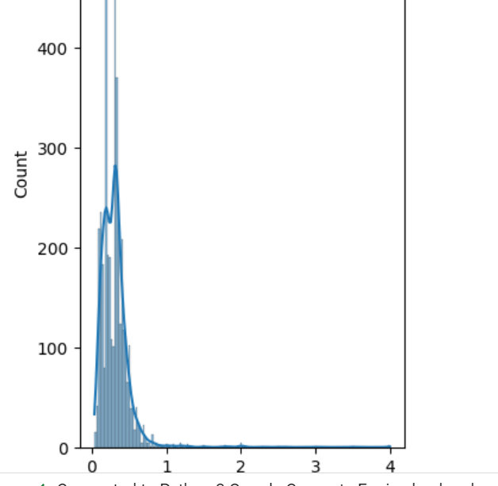
Univariate Analysis
A histogram of the ID in the AMCAT dataset shows the frequency of each unique ID or groups them into ranges. It helps visualize how candidate IDs are distributed, indicating trends or patterns in the dataset. Analyzing it can reveal if certain IDs are more common, suggesting clustering among candidates.
histogram of salary in the AMCAT dataset displays the distribution of candidates' salaries. It shows how many candidates fall within different salary ranges. Analyzing this histogram helps identify trends, such as the most common salary ranges and any outliers, providing insights into salary expectations in the job market.

Slide 7
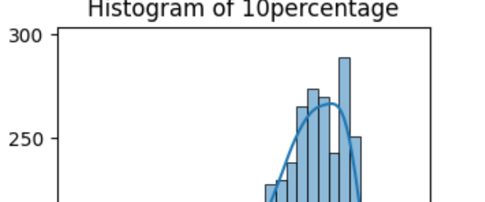
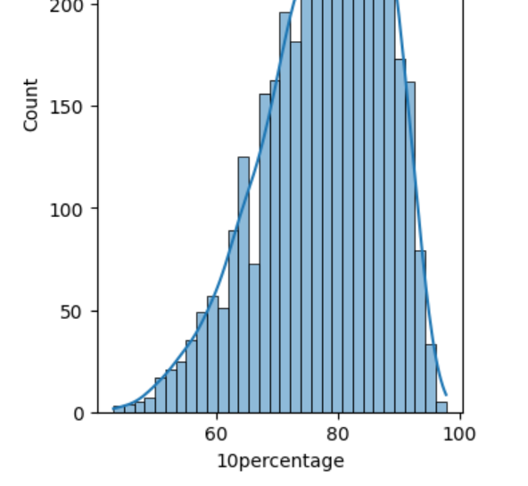
A histogram of the top 10 percent in the AMCAT dataset shows the distribution of candidates who scored in the highest 10 percent. It highlights the performance levels of the top achievers, helping to identify the skills and attributes of the best candidates.

Slide 8
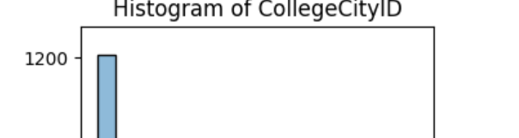
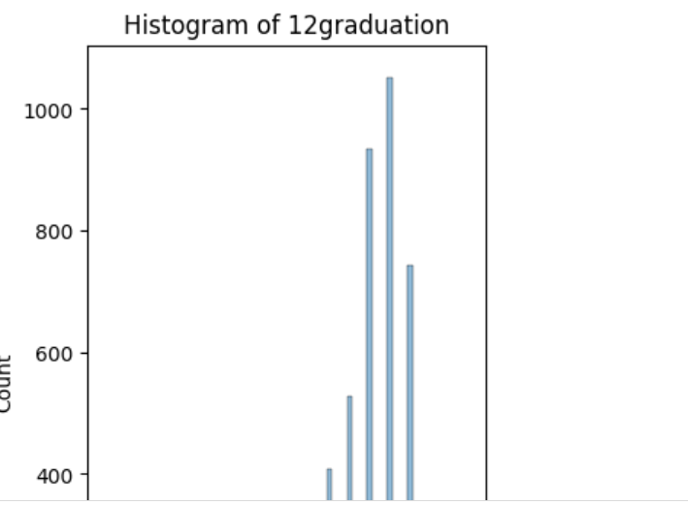
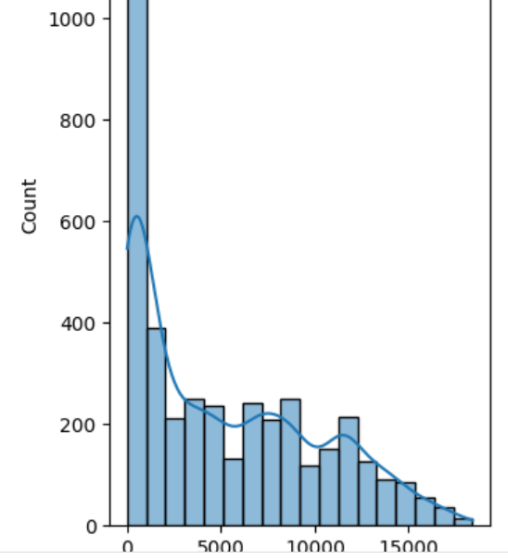
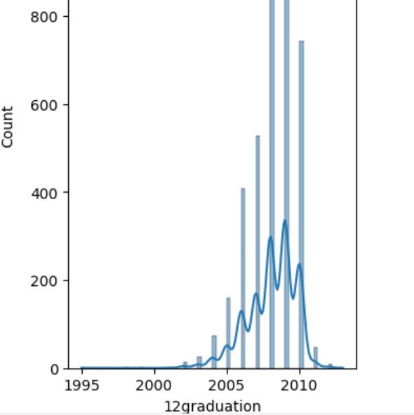
Histogram of collegecityid in the AMCAT dataset shows the distribution of candidates based on their college city IDs. It indicates how many candidates come from each city, helping to identify regional trends in candidate demographics.
Histogram of 12 graduation in the AMCAT dataset shows the distribution of candidates who graduated in 2012. It reveals how many candidates fall into different score ranges, helping to analyze their performance and trends among that specific graduation year.

Slide 9
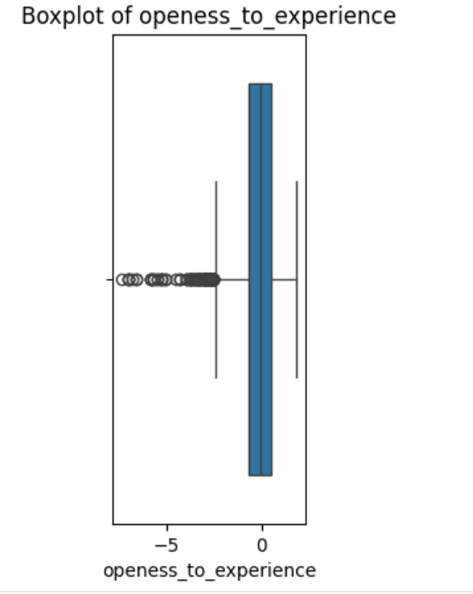
Box plot of openness to experience in the AMCAT dataset visually represents the distribution of candidates' scores on this trait. It shows the median, quartiles, and any outliers, helping to quickly assess the range and variability of openness among candidates.

Slide 10
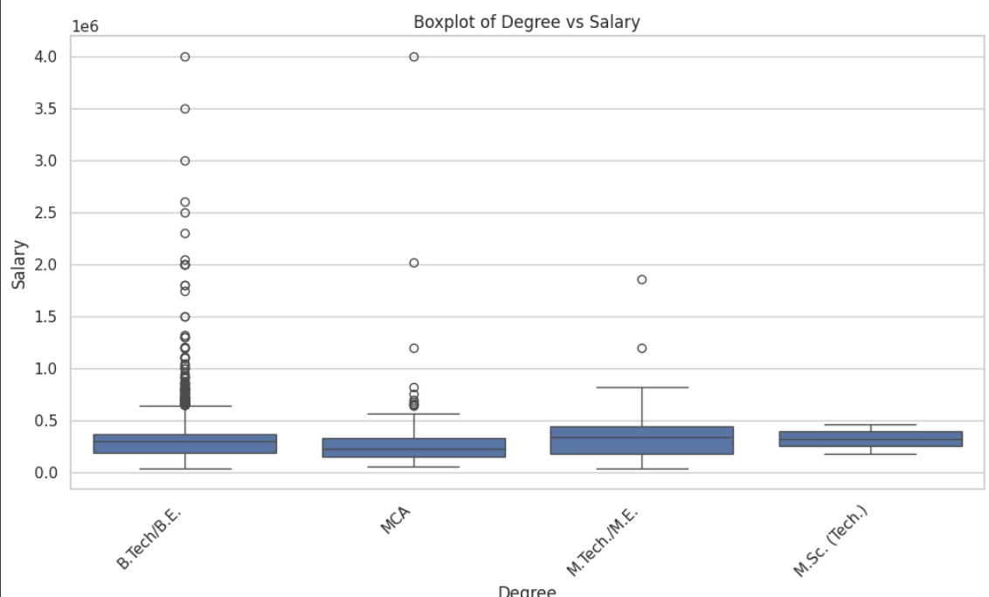
Bivariate Analysis
In bar plot of Degree vs Salary , the M.Tech/M.E. Degree has slightly High salary compare to others.
There certainly more outliers for B.Tech/B.E. Degree which tells it has chances of getting more higher salary in exceptional cases

Slide 11
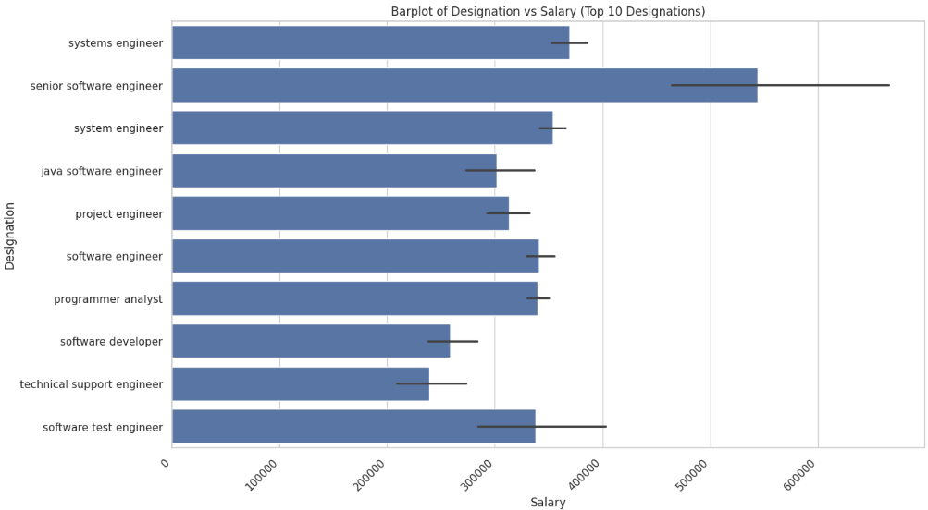
In Bar plot , It can be seen that senior software engineer having usually more salary compared to other designations
Technical support engineer having least salary among top 10 highest paid designations

Slide 12
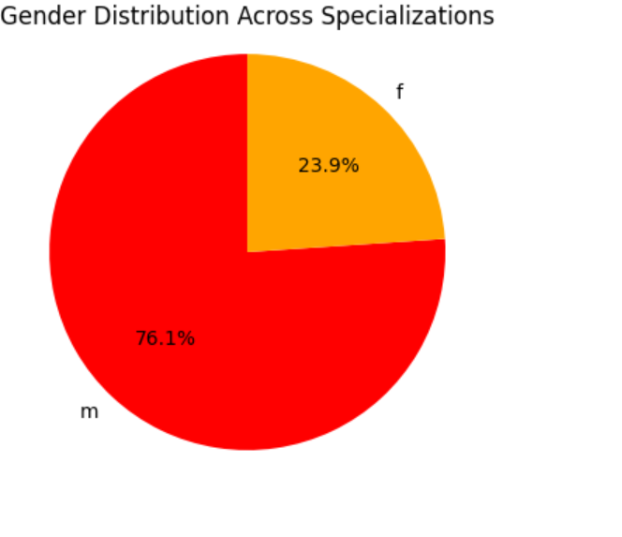
Gender distribution across specialization in the AMCAT dataset, shown in a pie chart, indicates that 23.9% of candidates are female and 76.3% are male. This highlights a significant gender imbalance in the specializations represented, reflecting the demographics of candidates in the dataset

Slide 13
Research Questions
Times of India article dated Jan 18, 2019 states that “After doing your Computer Science Engineering if you take up jobs as a Programming Analyst, Software Engineer, Hardware Engineer and Associate Engineer you can earn up to 2.5-3 lakhs as a fresh graduate.”

Slide 14
Conclusions
The analysis provided insights into the distributions of numerical variables, relationships between different variables, and addressed specific research questions.
The average salary for the specified job roles was found to be within the expected range. Additionally, the analysis revealed trends in specialization preferences based on gender.

Slide 15

THANK YOU

